Slide 1
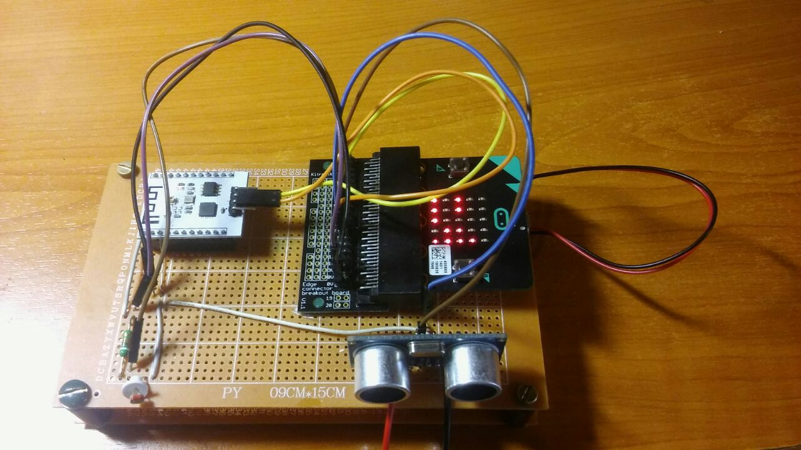
Machine learning microbit
Marin Šako

Slide 2
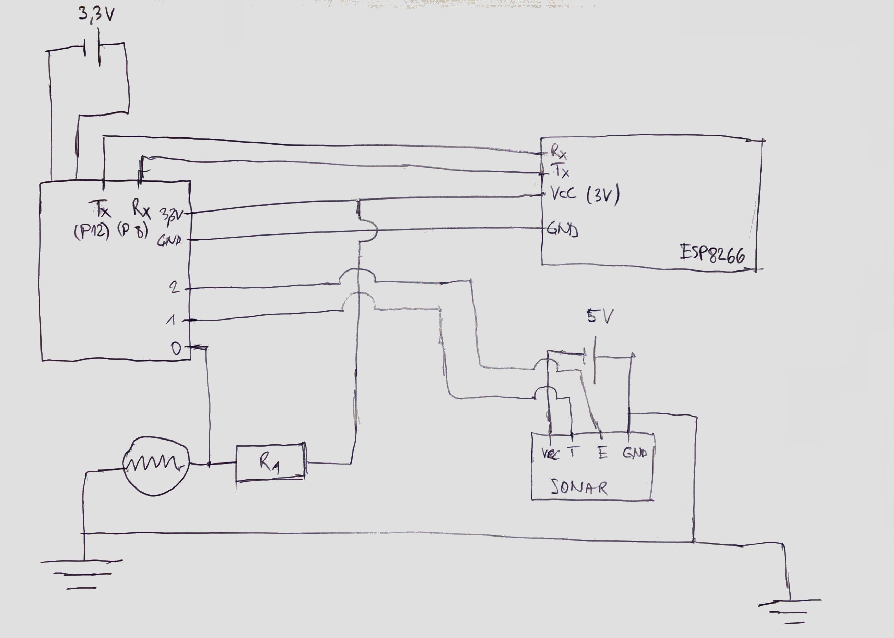

Slide 3
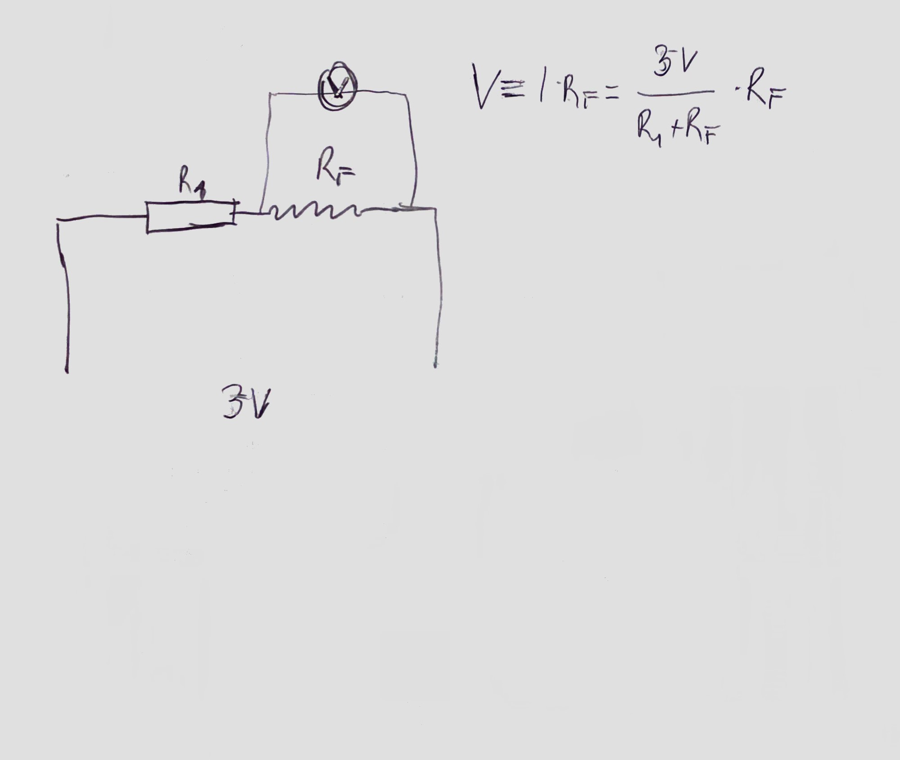

Slide 4
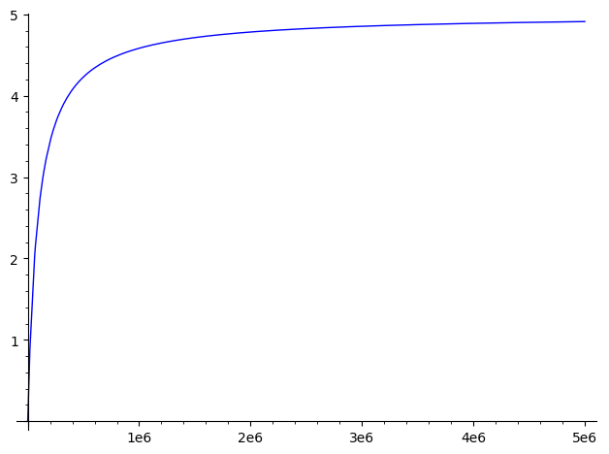

Slide 5
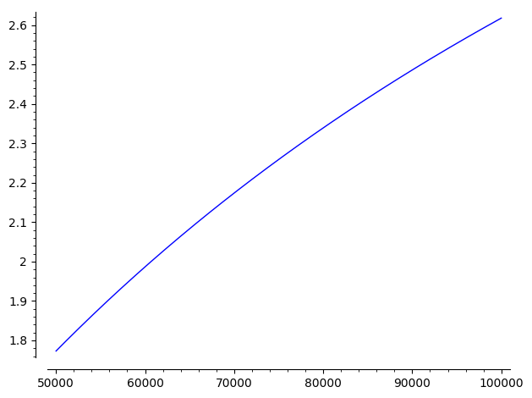

Slide 7
def h(theta,x):
return(1/(1+m.e**(x.dot(theta))))
def nauci(X,y,theta0):
theta = theta0
M = len(X)
while(True):
oldTheta = theta;
theta = theta - alfa*X.T.dot(y-h(theta,X))/M
if( norm(theta - oldTheta) < mi ):
break
return theta

Slide 8
HVALA NA PAŽNJI!

